Slide 1
AI Tools
File created on: 5/16/24 12:00:53 PM EDT

Slide 2
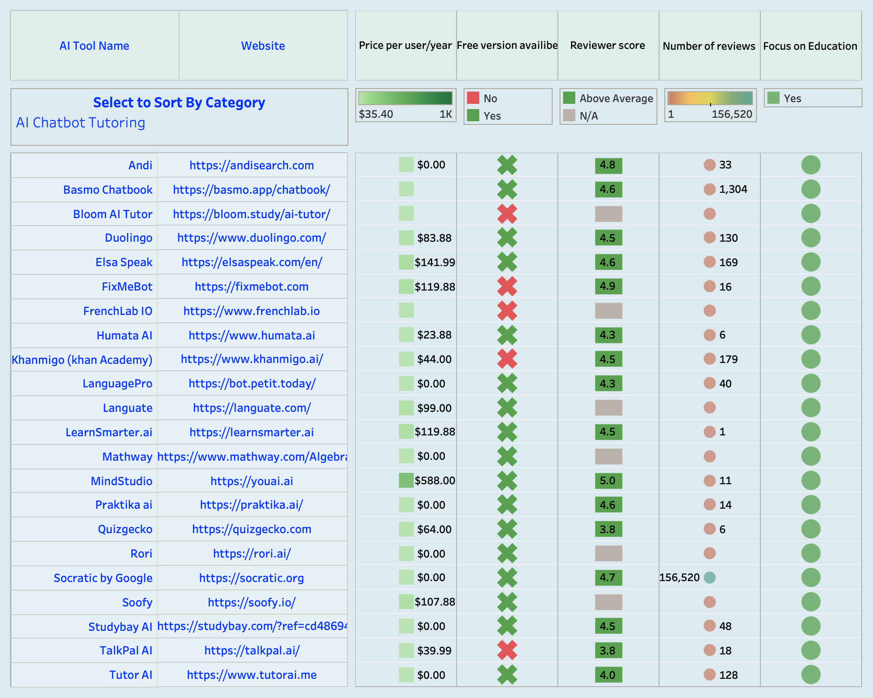

Slide 3
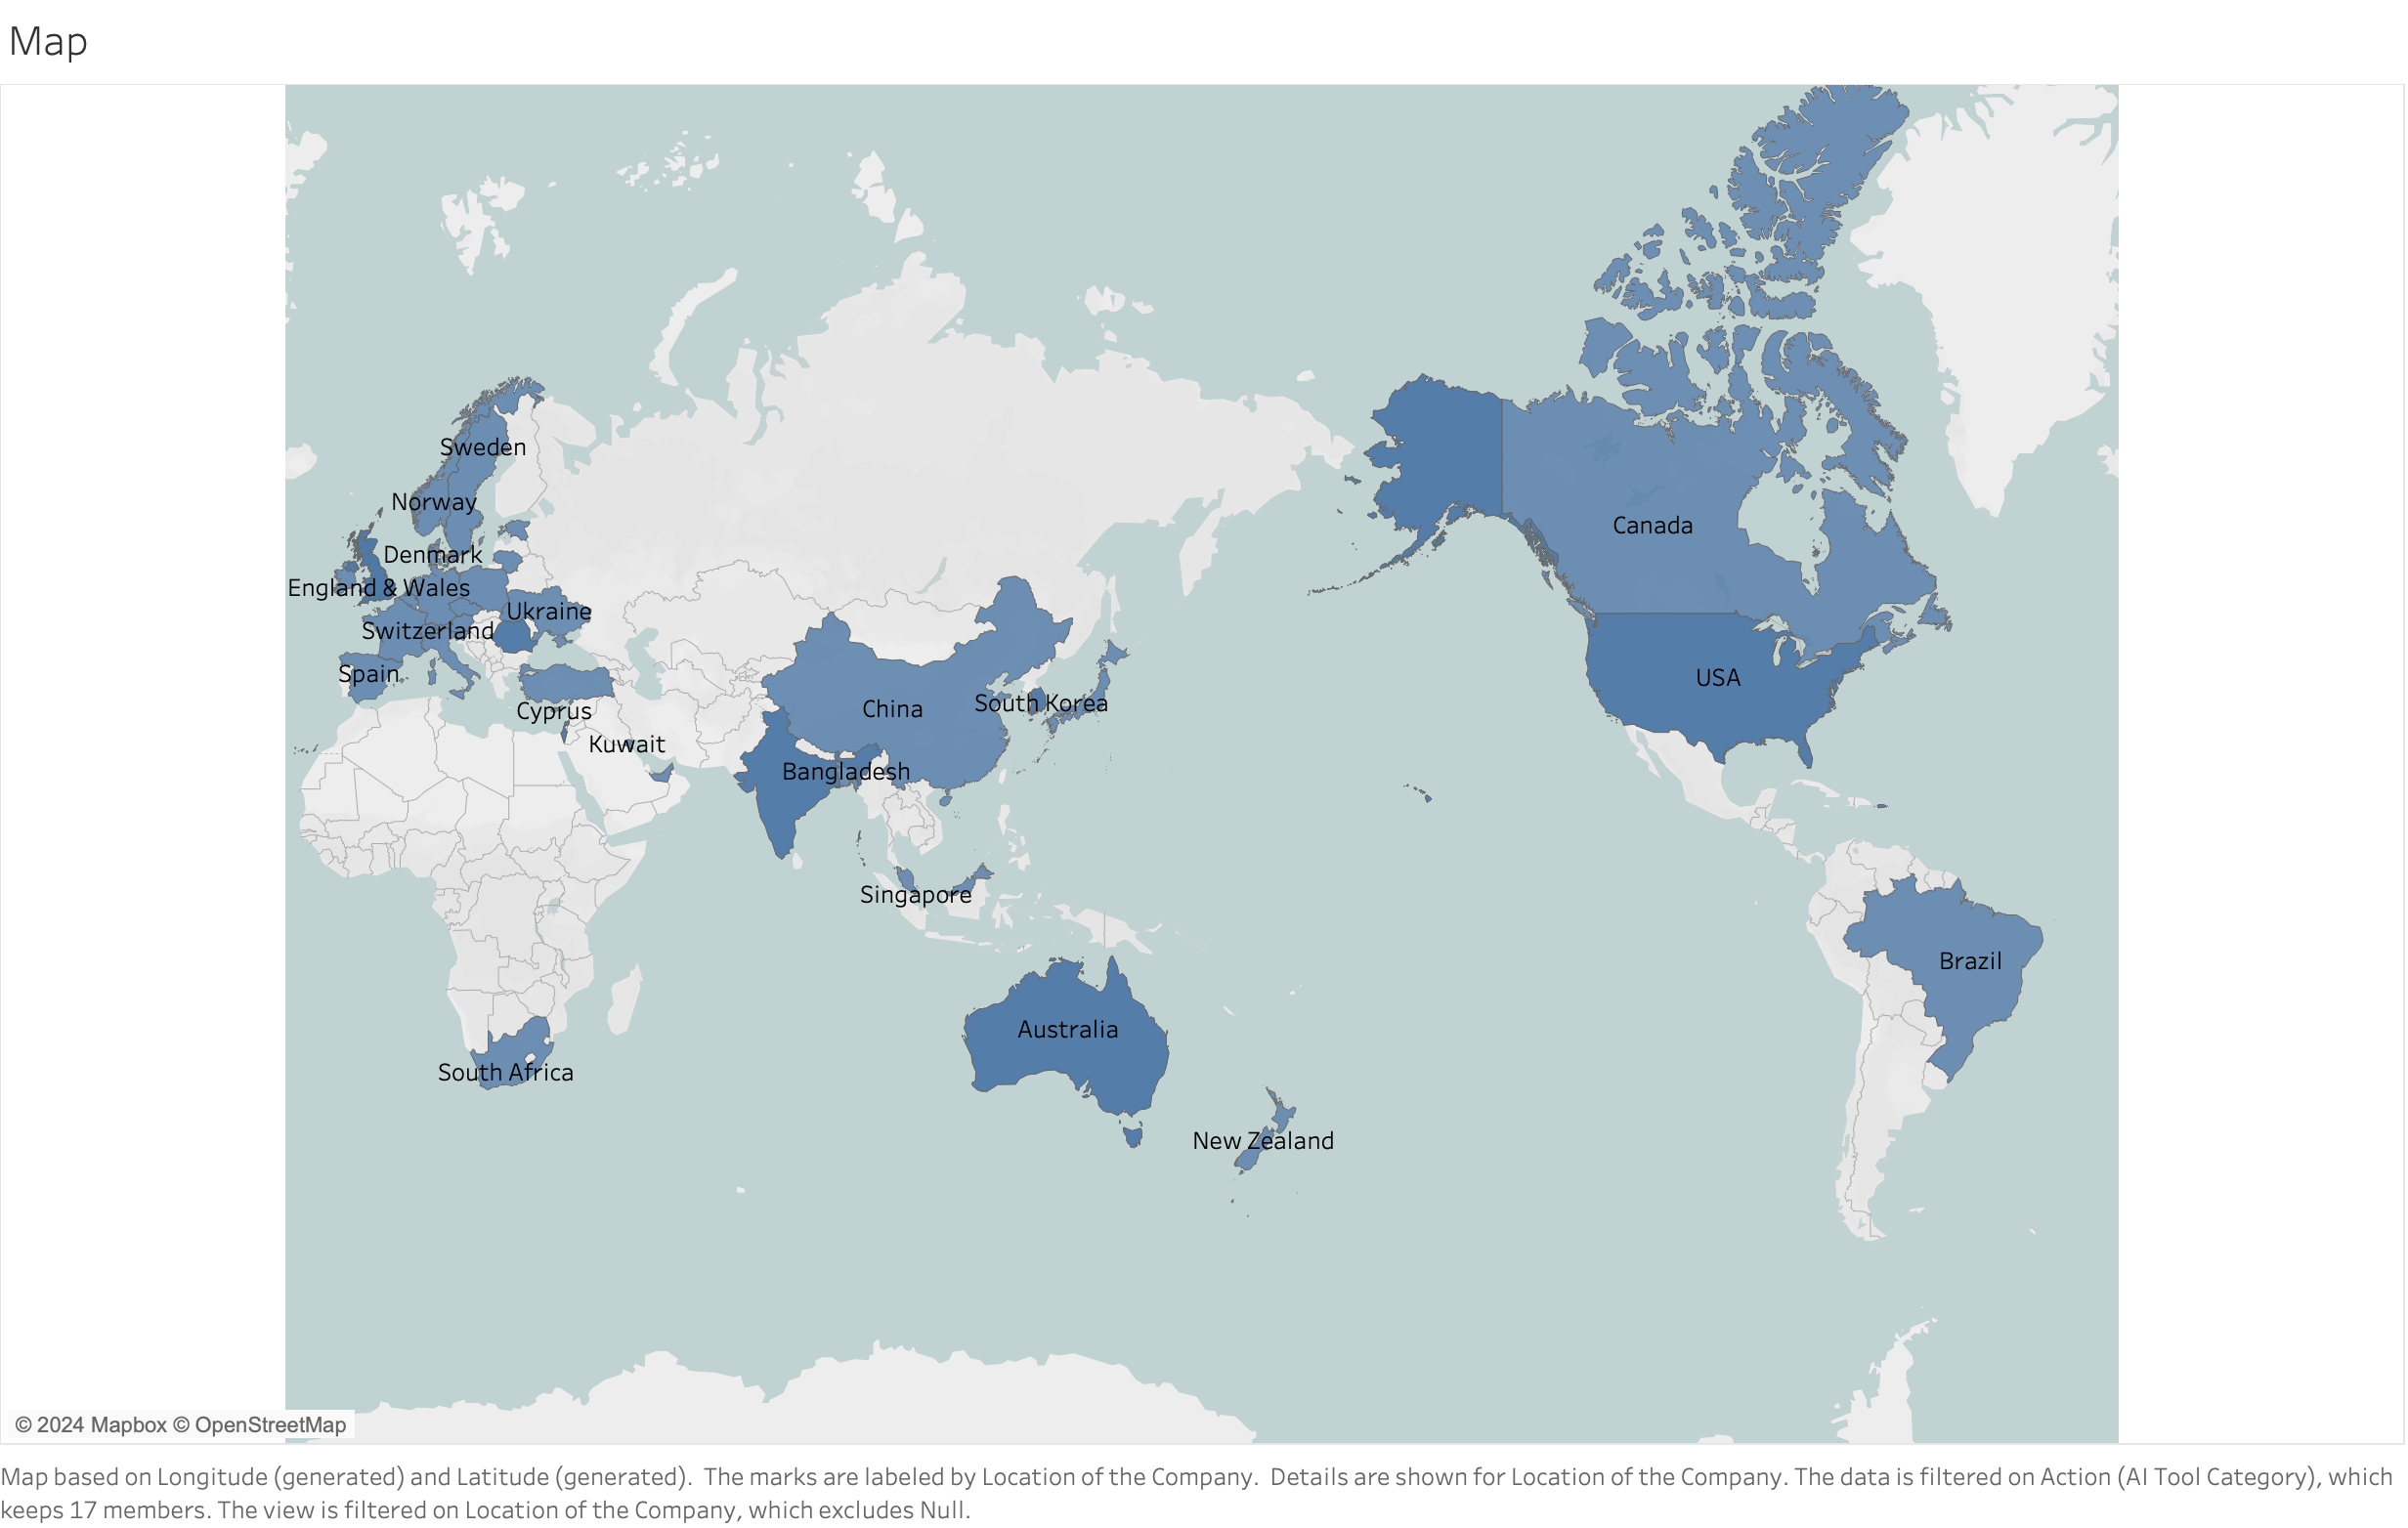

Slide 4
